Slide 1
Introduction to Forensic Psychiatry
Dr Susitha Mendis
Consultant Forensic Psychiatrist
Teaching Hospital , Karapitiya

Slide 2


Slide 3
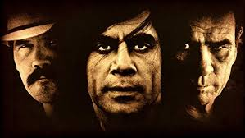

Slide 4
What is Forensic Psychiatry ?
Forensic Psychiatry is a subspecialty of psychiatry in which scientific and clinical expertise is applied in legal contexts involving civil, criminal, correctional, regulatory or legislative matters, and in specialized clinical consultations in areas such as risk assessment or employment.
Forensic psychiatry vs forensic psychology

Slide 5
Where is forensic psychiatry practised?
Multiple settings:
Security/ forensic hospitals
Prison hospitals/correctional facilities
Psychiatric hospitals /facilities
Community

Slide 6
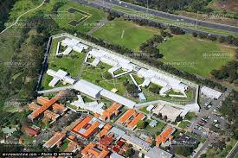

Slide 7
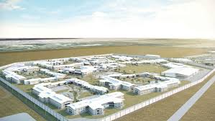

Slide 8
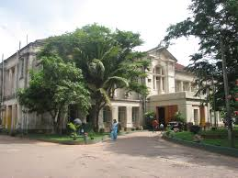

Slide 9
What do forensic psychiatrist do?
Multiple roles
Expert witness - Assist judiciary in the administration of justice
Clinical experts – help with challenging cases
Correctional/prison psychiatry
General therapeutic/clinical role

Slide 10
Nature of the forensic work ?
Forensic Mental Health Assessments (FMHA) -Capacity and risk assessments
Criminal profiling
Therapeutic role

Slide 11
Forensic Mental Health Assessments (FMHA)
Importance of client perspective
Voluntariness
Autonomy
Treats to validity
Relationships and dynamics
Pace and setting

Slide 12




Capacity/Competence Evaluations ?

Slide 13
Nature of the forensic work ?
Ethical framework
Dual role conflicts

Slide 14
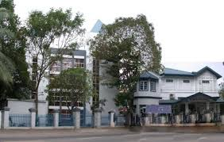
How can you become a forensic psychiatrist?

Slide 15

Thank you.

